Slide 1
Rubik’s Cube Solver
By Siddharth Gupta
Mentor : Sakshi Sinha

Slide 2
How it works?
Simple Image Processing: Demonstrated in next slides.
Takes a .jpg of each side of the cube as input
Converts the image to HSV from RGB.
Iterates the entire image pixel by pixel and filters out the desired colours one by one:
6 images, iterates 6 times over each image to filter out each colour.
For each colour on each side, Blobs are made for each colour and filtered on the basis of area and position.
Once the blobs are formed, all the colours on each side are stored in a 2-D array.
A URL is created on the basis of the scramble.
On accessing the URL, the solution of the cube is found.

Slide 3
Language Used: Open CV and C++/C

Slide 4
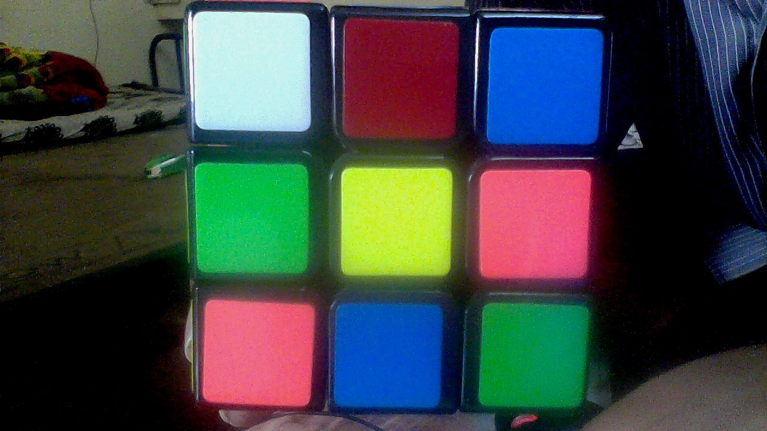
The .jpg Image

Slide 5
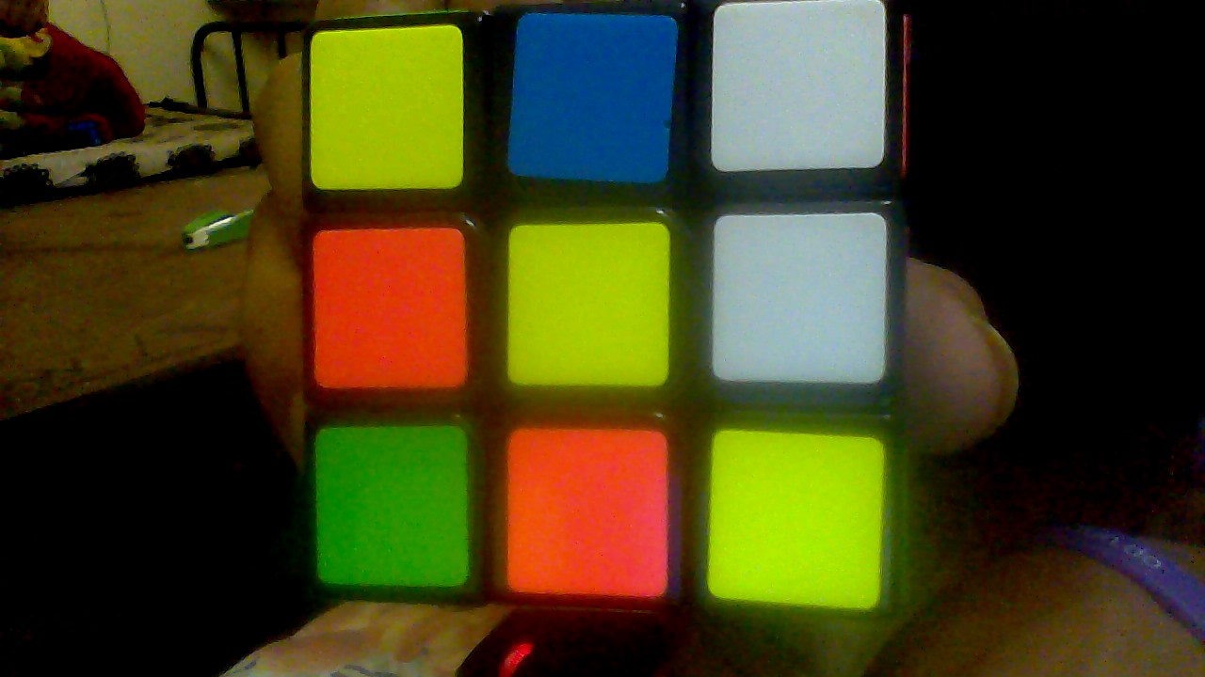
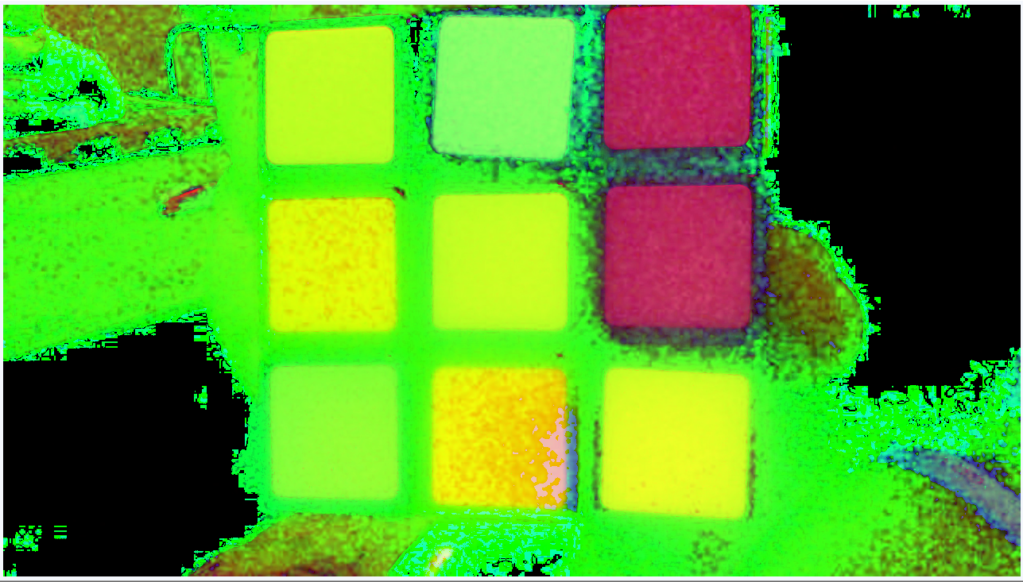
From RGB to HSV

Slide 6
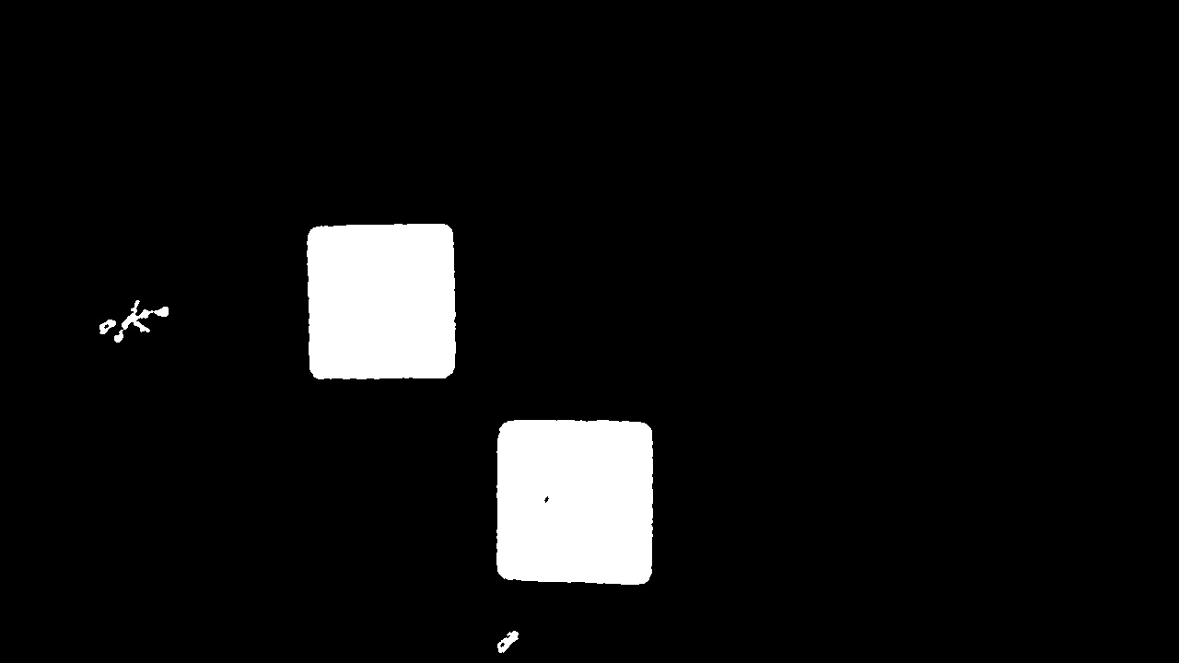
Iterate on each picture and Create Blobs

Slide 7
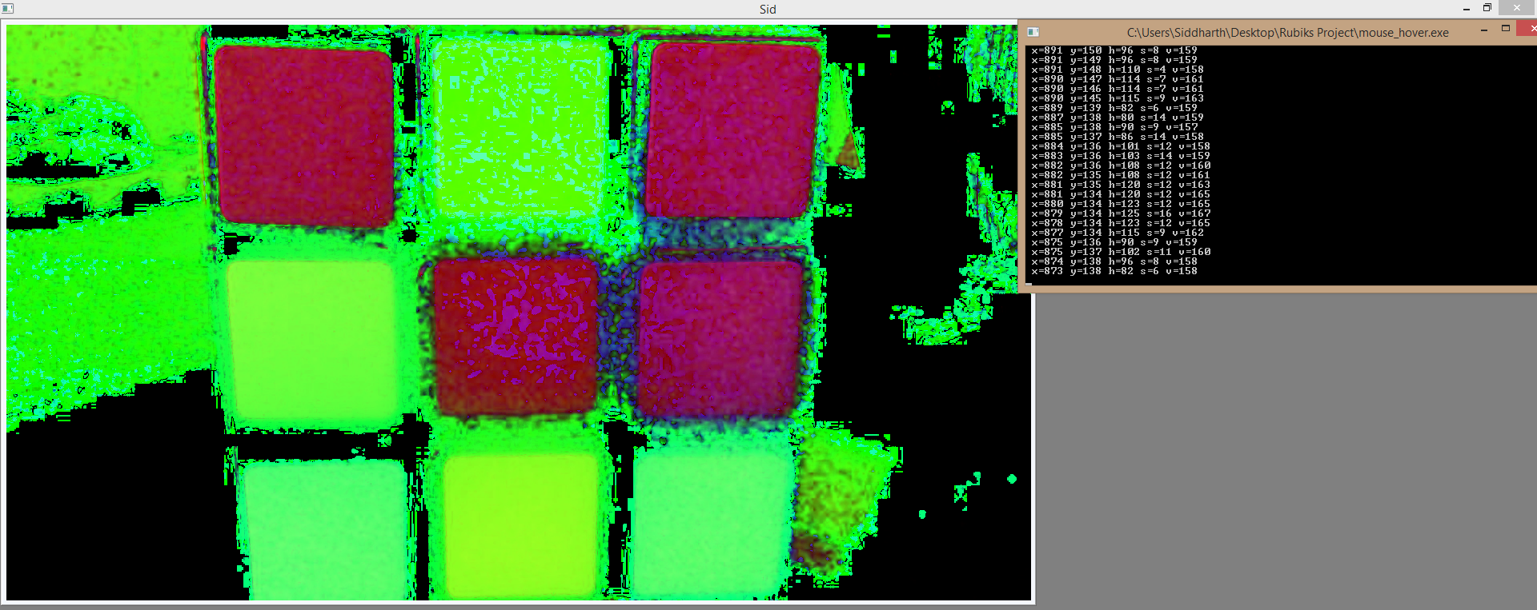
The filtering was done using the HSV values of the pixels.
A mouse_hover function was written which tells the HSV values of pixel on which the mouse points.

Slide 8
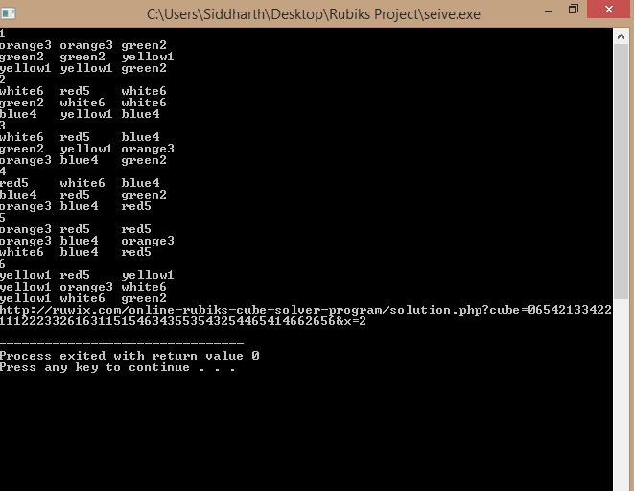
The Arrays of colours

Slide 9
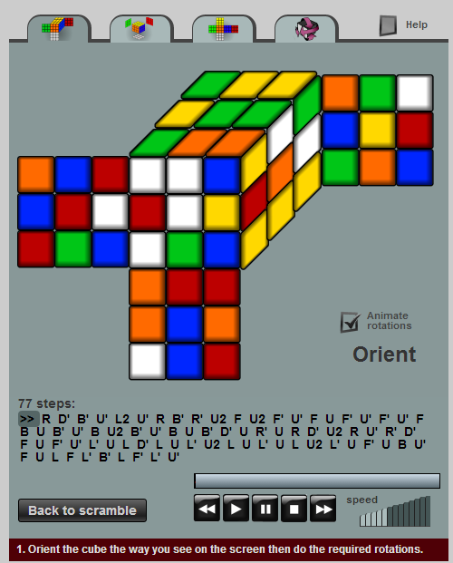
The Solution
Orient the cube as shown and apply the solution.

Slide 10
Thank You

